Slide 1
CSII FINAL PROJECT crossword game
By Maria Bacchetta
For Dr. Shadha Tabatabai

Slide 2
Contents
1- OOP
2- List Comprehension
3- File
4- Try-Except
5- Dictionary
6- Built-in functions with string
7- NumPy
8- Menu Function
9- Input Validation

Slide 3

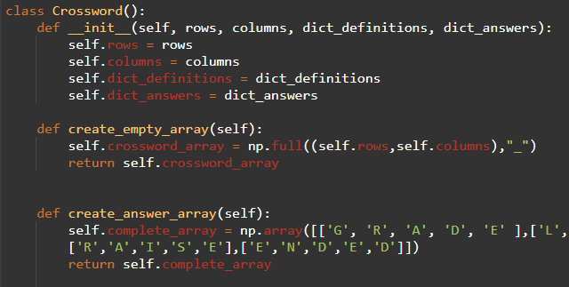

OOP
Crossword class is used to create the empty corsword and the answer crossword
Game1 is the current game (object) I have created, but more crossword games can be created in the future using the Crossword class
Game is a subclass of Crossword, containing the main functionalities of the game

Slide 4

List comprehension
Mainly used to display the items in a list to achieve a menu look
Also used to replace letters from a word with underscores so that the user sees blank spaces instead of the answer

Slide 5
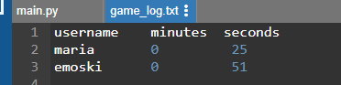
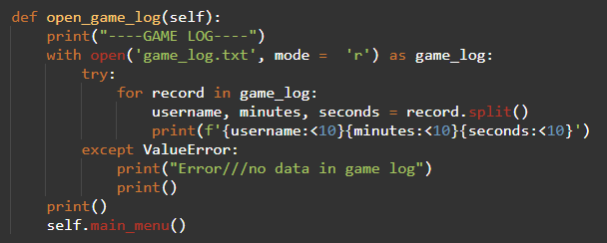
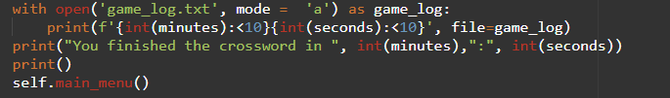
File
Used to create a game log with the user’s username and time taken to complete the crossword
User can choose to open/read the log file or not
Used try and except in case the user wants to open the log before having played

Slide 6
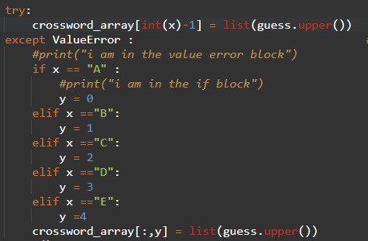
Try and except
Used to convert capital letters into column numbers
This is due to the definitions dictionary using capital letters as keys for “Down” words to avoid confusion
With try and except, there is no error and the code may continue to run

Slide 7
Dictionary
Dictionary for the definitions
Dictionary for the answers, using the same keys as the one used in dict_definitions
Lists are used for menu displays

Slide 8
Built-in function with string
Used .upper() built in function to change all the guesses into all caps so that the crossword is less confusing and to compare with the answer, “complete_array”, which uses all caps

Slide 9



NumPy
Crossword itself is a two dimension array with 5 rows and 5 columns
Used .full() NumPy function to fill the empty crossword with blanks
Used array_equal to compare the user’s crossword puzzle to the correct crossword puzzle
Mixed list built-in function and array to add word s to the matrix

Slide 10
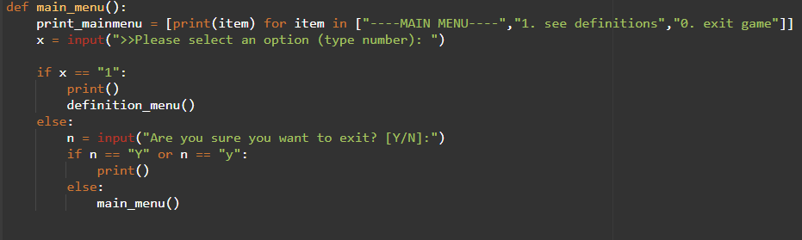
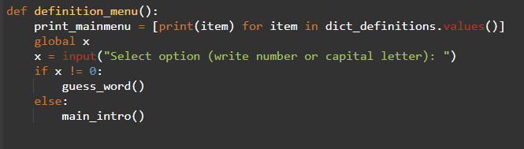
Menu Function

Slide 11
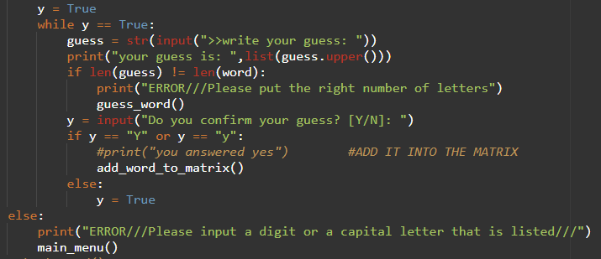
Input Validation
Used if/else block to ensure correct input
To avoid errors ending the code
To make sure user didn’t mistype

Slide 12
Takeaways and changes
NumPy is an incredibly powerful tool
List comprehension makes life much easier when trying to lay out information
Understood how to use NumPy and Try/Except much better
Understood File much better
Learned about “time” library in python, which is used to add clocks and timers
I would like to find a more efficient way of converting from capital letter to integer numbers, maybe using list or dictionary
Add a GUI to show the time elapsed while the user is playing
Solved the “create_answer_matrix()” so that I can create different crosswords without needing to hard-code

Slide 13
Link to onlinegdb : https://onlinegdb.com/ZI__ft2P4

